Slide 1
Sprint Execution, Review, and Retrospective

Slide 2
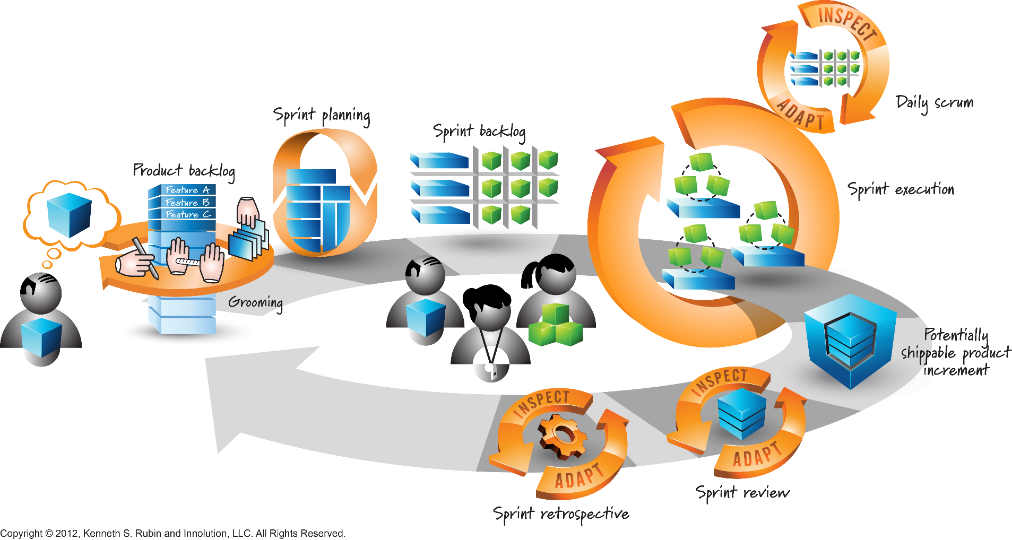
Sprint Execution in Scrum

Slide 3
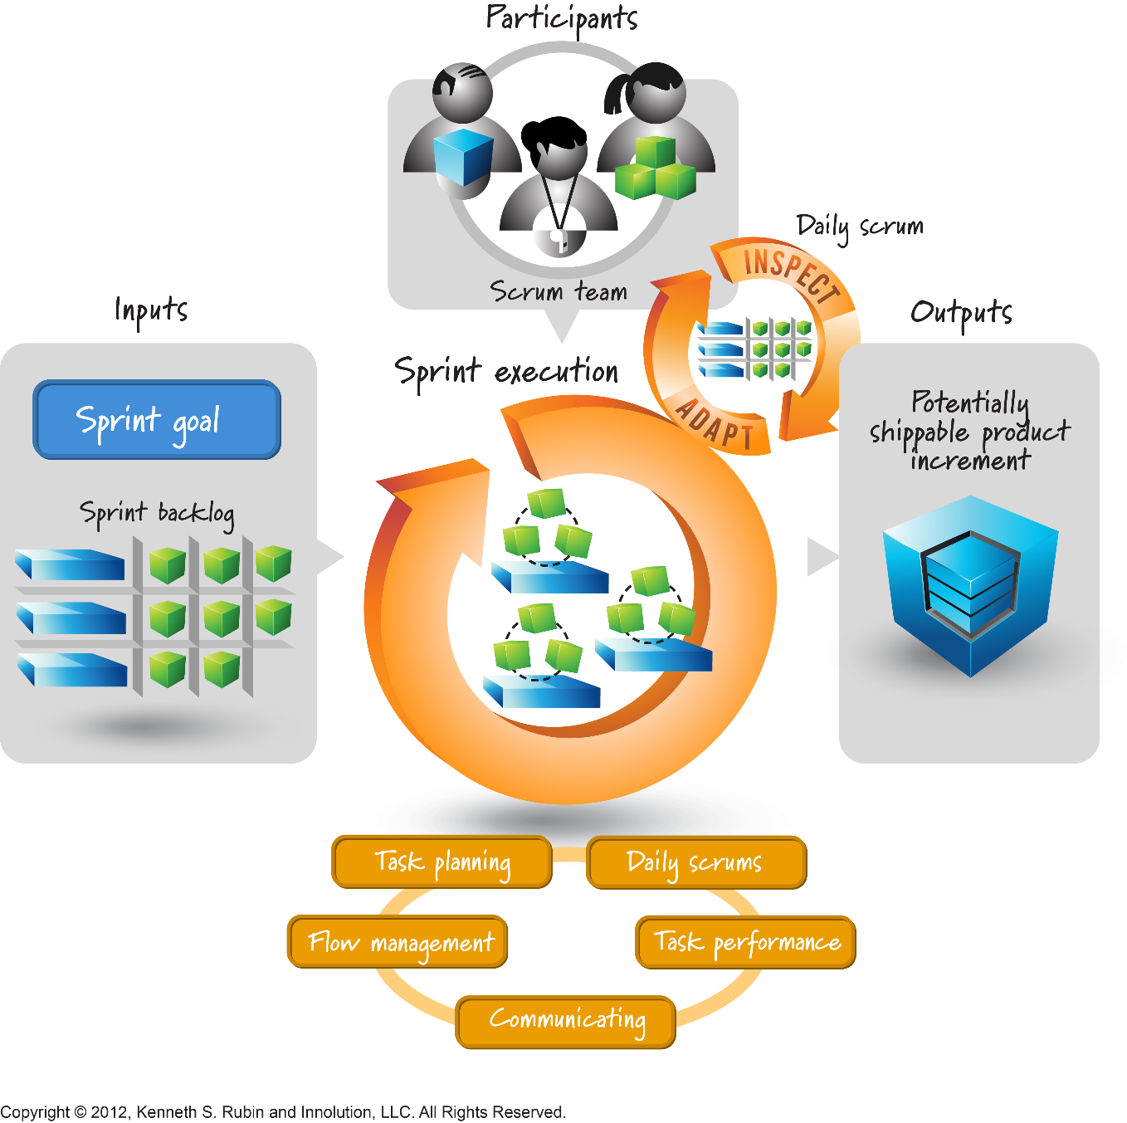
Sprint Execution

Slide 4

Daily Scrum Definition
A fifteen-minute daily meeting where the team synchronizes their efforts and any impediments reported that is preventing progress
Notes:
The sprint starts with a time boxed meeting (usually 10-15 min) so the team can organize and synchronize
It’s standup so people don’t talk too much (your feet get tired)

Slide 5



Daily Scrum Attendance
Core Scrum Roles attend Daily Scrum
  Product Owner, Scrum Master, Team Members
Attendance is mandatory
Synchronization meeting
Other’s: attendance is optional but these attendees should remain silent
Product
Owner
Development Team
ScrumMaster
Notes:
Scrum is focused on the daily scrum meeting where the team synchronizes work efforts, we will go over it more in detail later
2/20/2012
Software Development with Scrum

Slide 6
Daily Scrum Meeting
3 questions are asked of each Team Members
What have I done since the last Scrum meeting? (i.e. yesterday)
What will I do before the next Scrum meeting? (i.e. today)
What prevents me from performing my work as efficiently as possible?
Do you need any help?
Video: What is the Daily Scrum Meeting (Jeff Sutherland) https://www.youtube.com/watch?v=lXOhfKV6jLQ
Notes:
We focus on 3 questions
I actually added a 4th to make sure people ask for help early if they are struggling
Don’t let conversations go too far off of those questions, if they do, call a sidebar for after the meeting, those interested can attend

Slide 7
Daily Task Activities
During the sprint each team member works on the tasks they created during sprint planning
At the end of each day or after a task is done if not at the end of the day, the team member should update the effort remaining for a task
The effort remaining should not be calculated based on the original estimate determined during sprint planning minus the actual effort, the effort remaining should be the effort the team member believes is actually remaining
Notes:
We focus on 3 questions
I actually added a 4th to make sure people ask for help early if they are struggling
Don’t let conversations go too far off of those questions, if they do, call a sidebar for after the meeting, those interested can attend

Slide 8
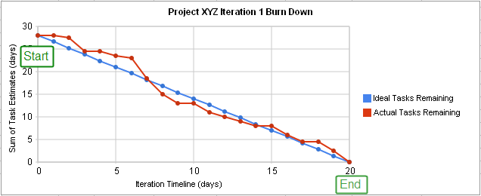
Burndown Chart
Sprint Burndown Chart:
  Depicts daily progress
  Updated by Scrum team
  Shows the amount of efforts remaining vs the number of days remaining
  The ideal line depicts the location on the chart the remaining hours should be for any given day to meet the goal
  On a daily basis the team looks at this visual to see if they can meet the sprint goal or not based on the effort remaining vs the capacity remaining
Notes:
So a sprint burndown focuses on the sprint, depicts daily progress
This can be updated by anyone, usually the Scrum Master posts it prior to the daily scrum
A product burndown is the same logic, it simply shows the number of story points defined for the feature
Each sprint, those are burned off

Slide 9
Sprint Burndown Chart
https://www.youtube.com/watch?v=CVwC6HeFHXQ
Burndown Charts Defined
Length (4:37)
Notes:
MON: 44 hrs
TUE: Done with online help, have 32 hrs
WED: 34 hrs UI went back up
THU: 18 hrs Done with UI, MT
FRI: 8 hrs

Slide 10
Sprint Review
A sprint review is held at the end of the sprint to inspect the increment and adapt the product backlog if needed
During the sprint review the Scrum Team and stakeholders collaborate about what was done in the sprint. Based on that and any changes to the Product Backlog during the sprint, attendees collaborate on the next things that could be done to optimize value
This is an informal meeting, not a status meeting, and the presentation of the increment is intended to elicit feedback and foster collaboration
Notes:
At the end of the sprint, the burndown will be 0 hours whether the team is done or not
If the feature is not done, it is pulled (with its hours) out of the sprint forcing the burndown to equal 0
The sprint review focuses only on those items deemed “done” by the team
They then are accepted/rejected by the product owner
Once done, we move on to planning the next sprint (after of course having a retrospective)

Slide 11
Sprint Review
The attendees include the Scrum Team and key stakeholders invited by the Product Owner
The Product Owner explains what Product Backlog Items have been “done” and what has not been “done”
The Development Team discusses what went well during the sprint, what problems it ran into, and how those problems were solved
The Development Team demonstrates the work that was done and answer questions about the increment
The Product Owner discusses the Product Backlog as it stands, projecting likely target and delivery dates based on progress to date (if needed)
The entire group collaborates on what to do next, so the Sprint Review provides valuable input to subsequent Sprint Planning
The result of the Sprint Review is a revised Product Backlog that defines the probable Product Backlog items for the next sprint.
Video: Scrum The Sprint Review Process (Jeff Sutherland)
https://www.youtube.com/watch?v=2Jhf7PcYrzY
Notes:
At the end of the sprint, the burndown will be 0 hours whether the team is done or not
If the feature is not done, it is pulled (with its hours) out of the sprint forcing the burndown to equal 0
The sprint review focuses only on those items deemed “done” by the team
They then are accepted/rejected by the product owner
Once done, we move on to planning the next sprint (after of course having a retrospective)

Slide 12
Sprint Retrospective
The Sprint Retrospective is an opportunity for the Scrum Team to inspect itself and create a plan for improvements to be enacted during the next Sprint
The Sprint Retrospective occurs after the Sprint Review and prior to the next Sprint Planning
The Scrum Master ensures the meeting is positive and productive and teaches all to keep it within the time-box
The Scrum Master participates as a peer team member in the meeting from the accountability over the Scrum process
Notes:
I talked about inspect and adapt
The retrospective is how we accomplish this
Discuss what went well or not and talk about improvements

Slide 13
Sprint Retrospective
The purpose of the Sprint Retrospective
Inspect how the last sprint went with regards to people, relationships, process, and tools
Identify and order the major items that went well and potential improvements
Create a plan for implementing improvements to the way the Scrum Team does its work
By the end of the sprint retrospective the Scrum Team should identify improvements that it will implement in the next Sprint.
Video: Inside the Sprint Retrospective (Jeff Sutherland)
https://www.youtube.com/watch?v=MFLvQXMNrO8
Notes:
I talked about inspect and adapt
The retrospective is how we accomplish this
Discuss what went well or not and talk about improvements

Slide 14
Additional Resources
Sprint Review Anti Patterns
https://www.youtube.com/watch?v=G6nC7l86pJQ
(length 4:30)
Agile Retrospectives Done Right
https://www.youtube.com/watch?v=dJNCHvqKljU
(length 5:00)

